Slide 1
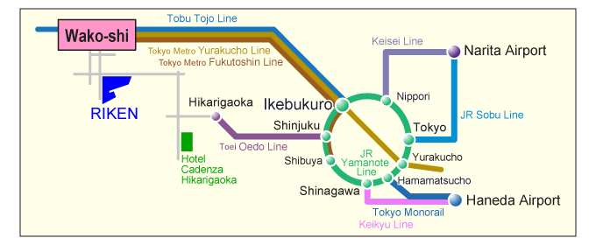
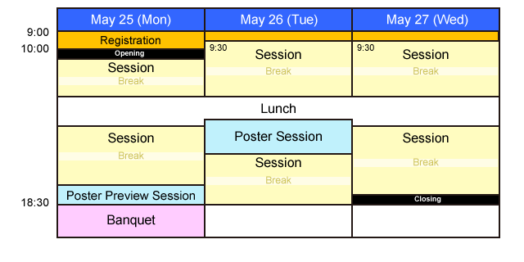
Abstract Title (example 1)
F. Kagawa¹, and N. Nagaosa^{1,2}
¹RIKEN Center for Emergent Matter Science (CEMS), Wako, Saitama 351-0198, Japan
²Department of Applied Physics, University of Tokyo, Tokyo 113-8656, Japan
Topology is now considered to be an important guiding principle in condensed matter physics. Topological insulator is its representative example, and the even more rich physics is expected when topology is combined with the strong electron correlation.
Magnetism is the most typical phenomenon driven by the correlation. Actually the topological spin textures such as domain wall, vortex, skyrmion, and even monopole are now being intensively studied experimentally and theoretically. On the other hand, the topological objects such as monopole and skyrmion in momentum space are often relevant to the electronic states of magnets. In this workshop, we will discuss the vital role of topology in magnets with the concrete topics including
Topological textures in magnets (Skyrmion, monopole, domain wall etc.)
Magnetic topological insulators
Quantum transports in magnets
Weyl semimetals
First-principles calculations
Fig. 1 The access map of RIKEN.
Fig. 2 The Workshop schedule.

