Slide 1
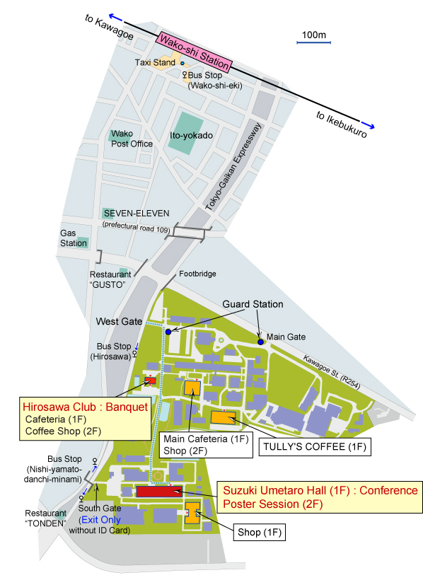
Abstract Title (example 2)
S. Seki^{A}, and Y. Tokura^{A,B}
^{A}RIKEN CEMS, ^{B}University of Tokyo
TRANSPORTATION
WAY TO THE HALL
From Narita Airport (NRT) to Wako-shi Station
Narita Airport >> Nippori Station | Keiwei Line [Skyliner] (approx. 40 min.) | JR Narita Express (approx. 90 min.)
Nippori Station >> Ikebukuro Station | JR Yamanote Line (approx. 12 min.)
Ikebukuro Station >> Wako-shi Station | Tobu Tojo Line / Express and Semi Express (approx. 12 min.)
 | Tokyo Metro Yurakucho Line / Local (approx. 19 min.)
 | Tokyo Metro Fukutoshin Line / Express (approx. 14 min.)
The conference hall (Suzuki Umetaro Hall) is 20 minutes walk from Wako-shi station.
From Haneda Airport (HND) to Wako-shi Station
Haneda Airport >> Shinagawa Station | Keikyu Lines (approx. 16 min.)
Shinagawa Station >> Ikebukuro Station | JR Yamanote Line (approx. 26 min.)
Ikebukuro Station >> Wako-shi Station | same as above

