Slide 1
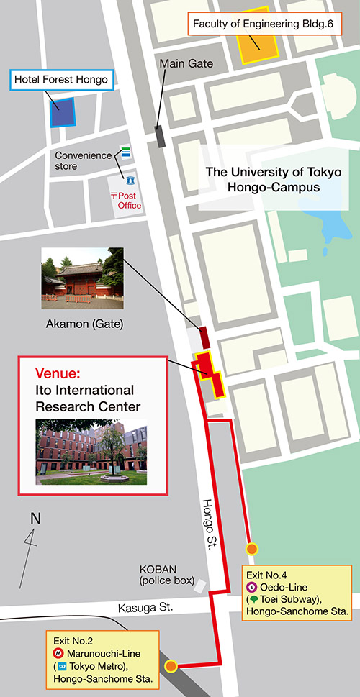
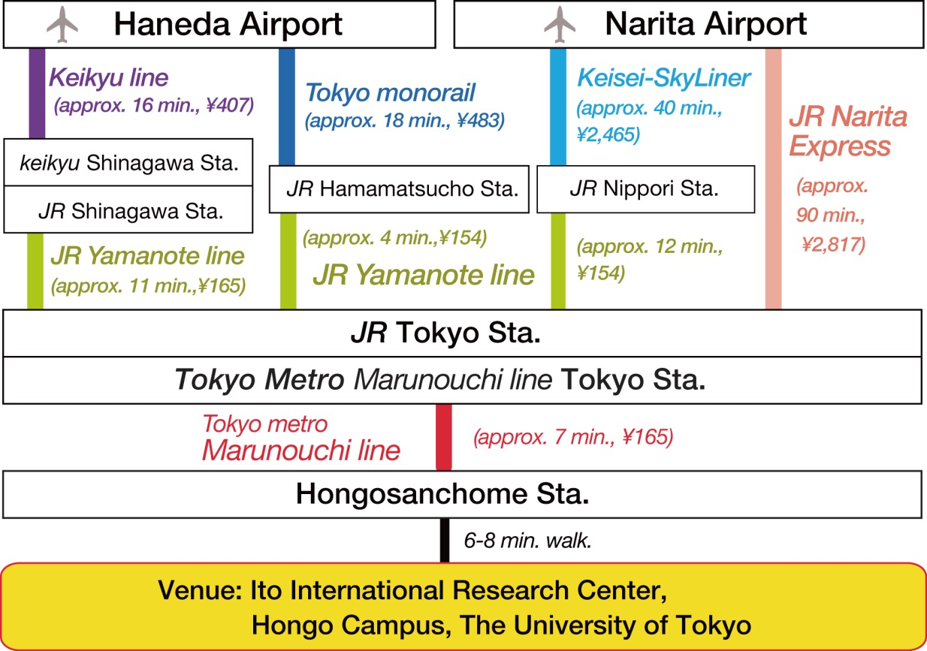
Abstract Title (example 2)
S. Shimizu^{A}, and Y. Iwasa^{A,B}
^{A}RIKEN CEMS, ^{B}University of Tokyo
TRANSPORTATION
WAY TO THE VENUE
From Airport to the venue
The conference venue ( Ito International Research Center) is
8 minutes walk from Hongo-sanchome station.

