Slide 1
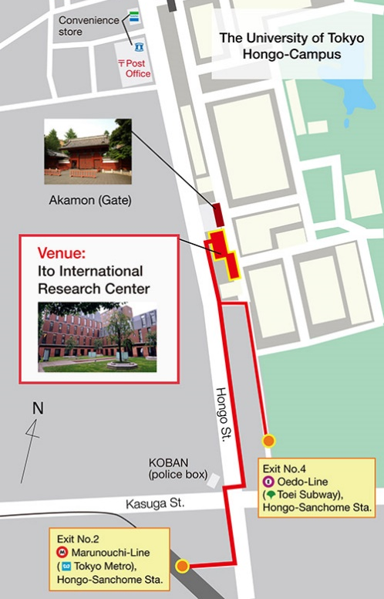
Abstract Title (example 2)
Hitoshi Seo and Akira Furusaki
RIKEN CEMS
TRANSPORTATION
WAY TO THE VENUE
From Airport to the venue
The symposium venue ( Ito International Research Center) is 8 minutes walk from Hongo-sanchome station.

