Slide 1
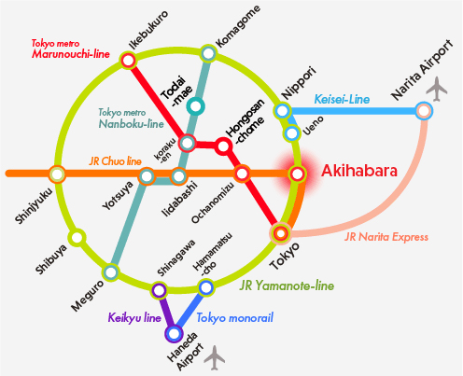
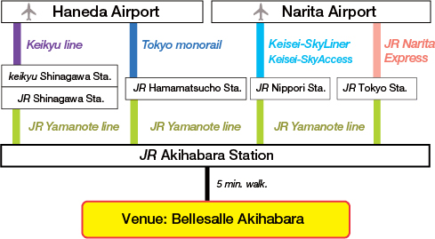
Abstract Title (example 2)
Hitoshi Seo and Akira Furusaki
RIKEN CEMS
Transportation
Train map to the venue
From Airport to the venue

