Slide 1
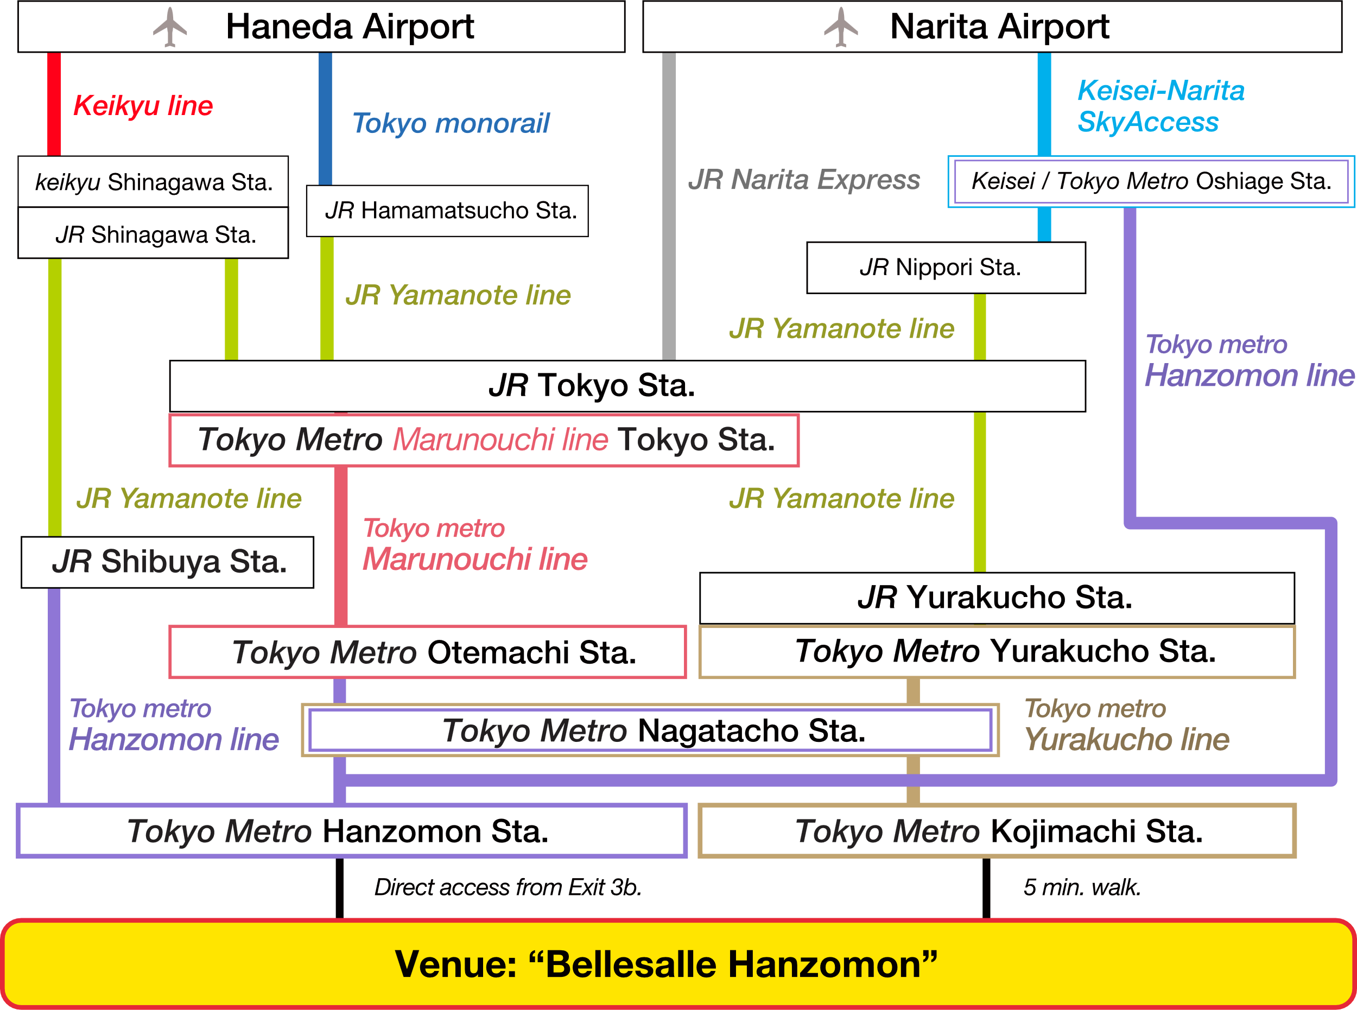
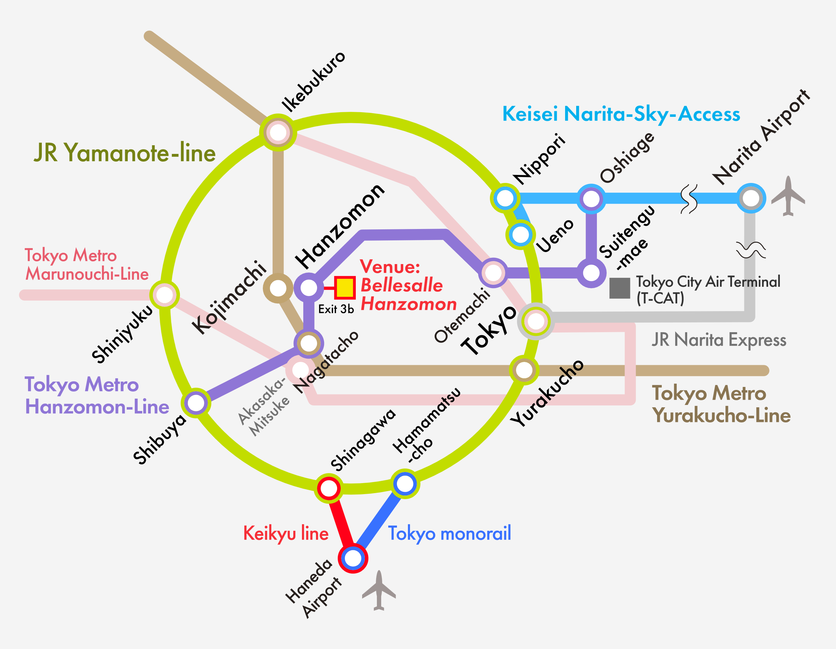
Abstract Title (example 2)
Xiuzhen Yu
RIKEN CEMS
TRANSPORTATION
WAY TO THE VENUE
From Airport to the venue
The symposium venue “Bellesalle Hanzomon”, direct access from exit 3b of Hanzomon station, Tokyo Metro Hanzomon-line..

